Slide 1
Same day delivery for Amazon
By :- Ronak Lotia

Slide 2
Problem Statement
The problem was to delivery the product on the same day instead on him waiting for two or three days.

Slide 3
Solution
Same day delivery can be possible by having strategically located distribution centers i.e. either have a contract or partnerships with Manufactures, Distributors, Suppliers or wholesalers.
All of the manufacturers, distributors, suppliers or wholesalers will manage their inventory and get the product that will be available for sales.

Slide 4
Features of the Solution
The system is geographic in nature.
There is virtual inventory of local system which is assembled dynamically.
All the Invoicing and payment options handled by Amazon.
Main feature of this project is the close proximity algorithm.

Slide 5
Benefits
In existing system Customers have to wait for a couple of days for a to get their order, but implementing the same day delivery problem customers wont have to wait for a long to time to get their order.
Amazon will also benefited because right now no one else is doing the concept of same day delivery all over the world.
Because of the close proximity Amazon can increase their virtual inventory which will be benefited both for Amazon as well as Customers.

Slide 6
Use Case
Various Use Case of the system are
1 Customer
1.a Browse product catalog
1.b Check order status
1.c Book order

Slide 7
Use Case
1 Retailer Order Processing Role
1.a Assign Order
1.b View All Order
1.c Send Delivery Request to Shipment Organization

Slide 8
Use Case
Shipment And Packing Role
1.a Pack The Product
1.b Generate Tracking ID
1.c Ship The Product To Customer

Slide 9
Use Case
Retailer Finance Role
1.a Generate invoice For order
1.b Pay invoice for Return Orders
1.c Pay Penalties for late Delivery

Slide 10
Use Case
Amazon Finance Role
1.a Pay Retailer
1.b Debits Customer Account
1.c Credit Customer Account incase of Return

Slide 11
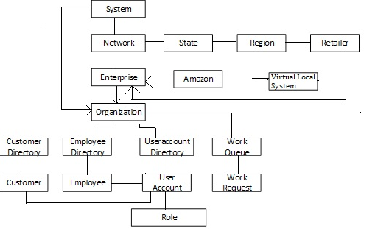
Object Model

Slide 12
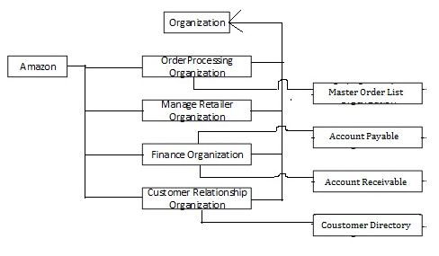
Amazon Enterprise

Slide 13
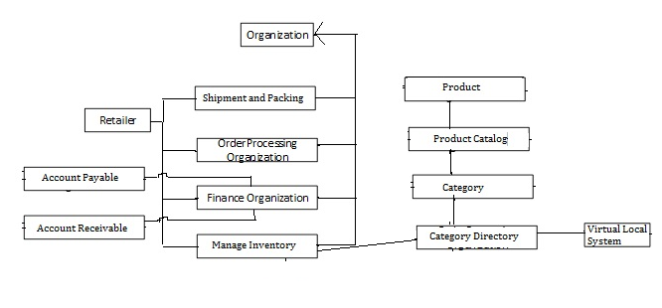
Retailer Enterprise

Slide 14
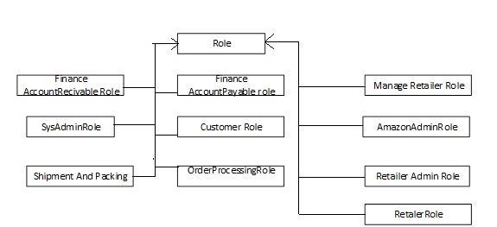
Roles in the system

Slide 15
Future Scope
Can implement some algorithms to calculate distance between to cities because it will help us to know the all the nearby region from where one day delivery is possible.

Slide 16
Thank You

